Slide 1
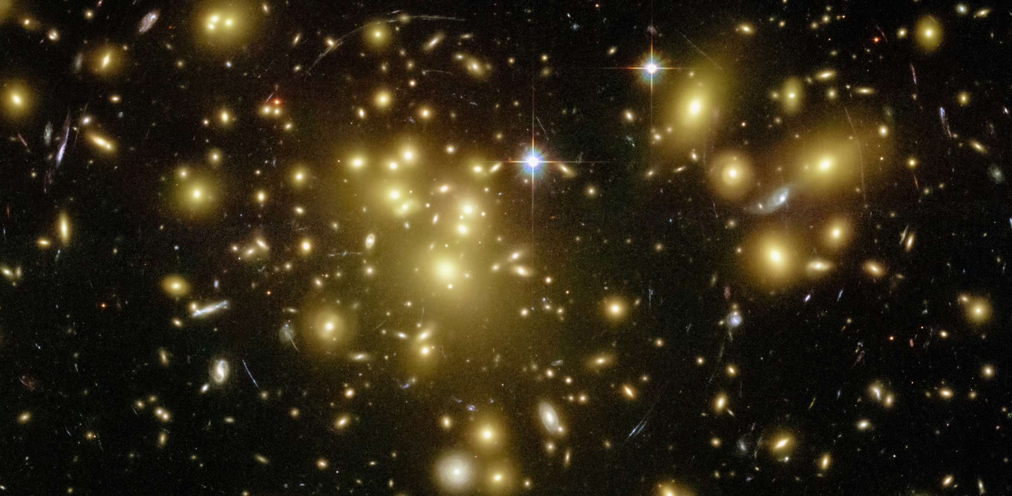
An MMD Approach to Inferring Weak Lensing Convergence from Galaxy Sizes
Santiago Brunner
Semester Project,
Supervised by Prof. Refregier, Veronika Oehl
15 December 2025, Zurich
NASA Hubble Space Telescope
Notes:
Hook: Shear for 30yrs, convergence neglected. What have we been missing out on?
We lack a statistical method to reliably extract convergence signals from galaxy sizes.
Benefits: Independent weak lensing probe, validates shear-based results, tighter cosmological constraints by combining probes, maximal information extraction from existing surveys

Slide 2

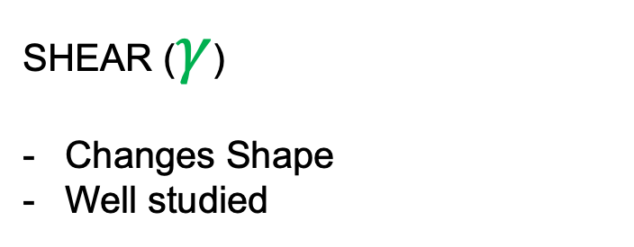

Weak Lensing: Two Observable Effects
$$γ$$
Weak Lensing
SHEAR ($γ$)
Changes Shape
Well studied

Slide 3

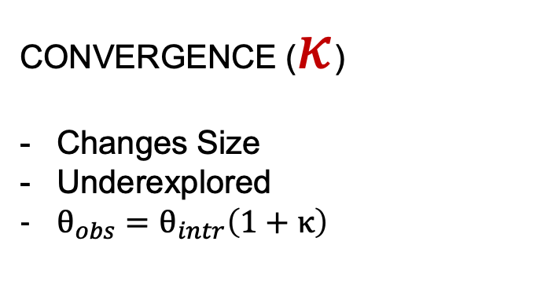
Weak Lensing: Two Observable Effects
$$γ$$
$$κ$$
Weak Lensing
SHEAR ($γ$)
Changes Shape
Well studied
CONVERGENCE ($κ$)
Changes Size
Underexplored
$θ_{obs}=θ_{intr}\left(1+κ\right)$

Slide 4
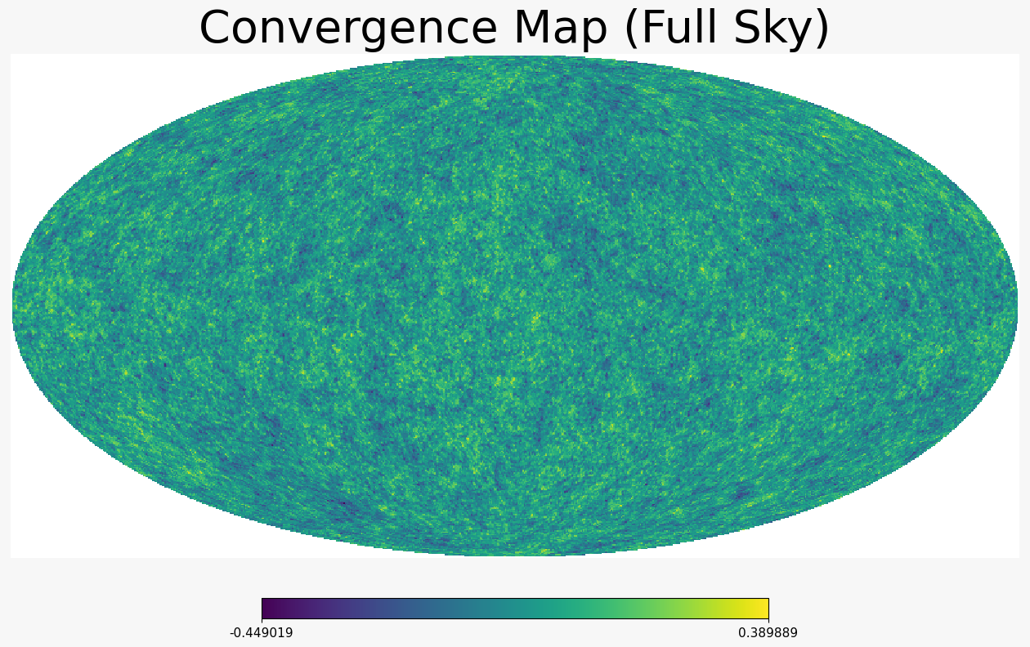
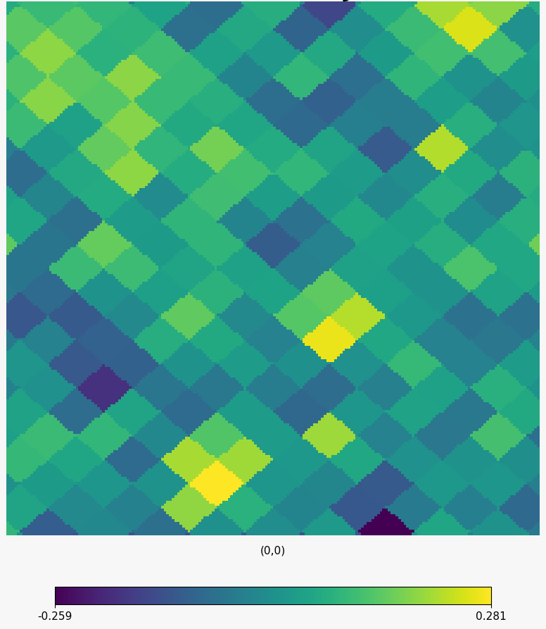
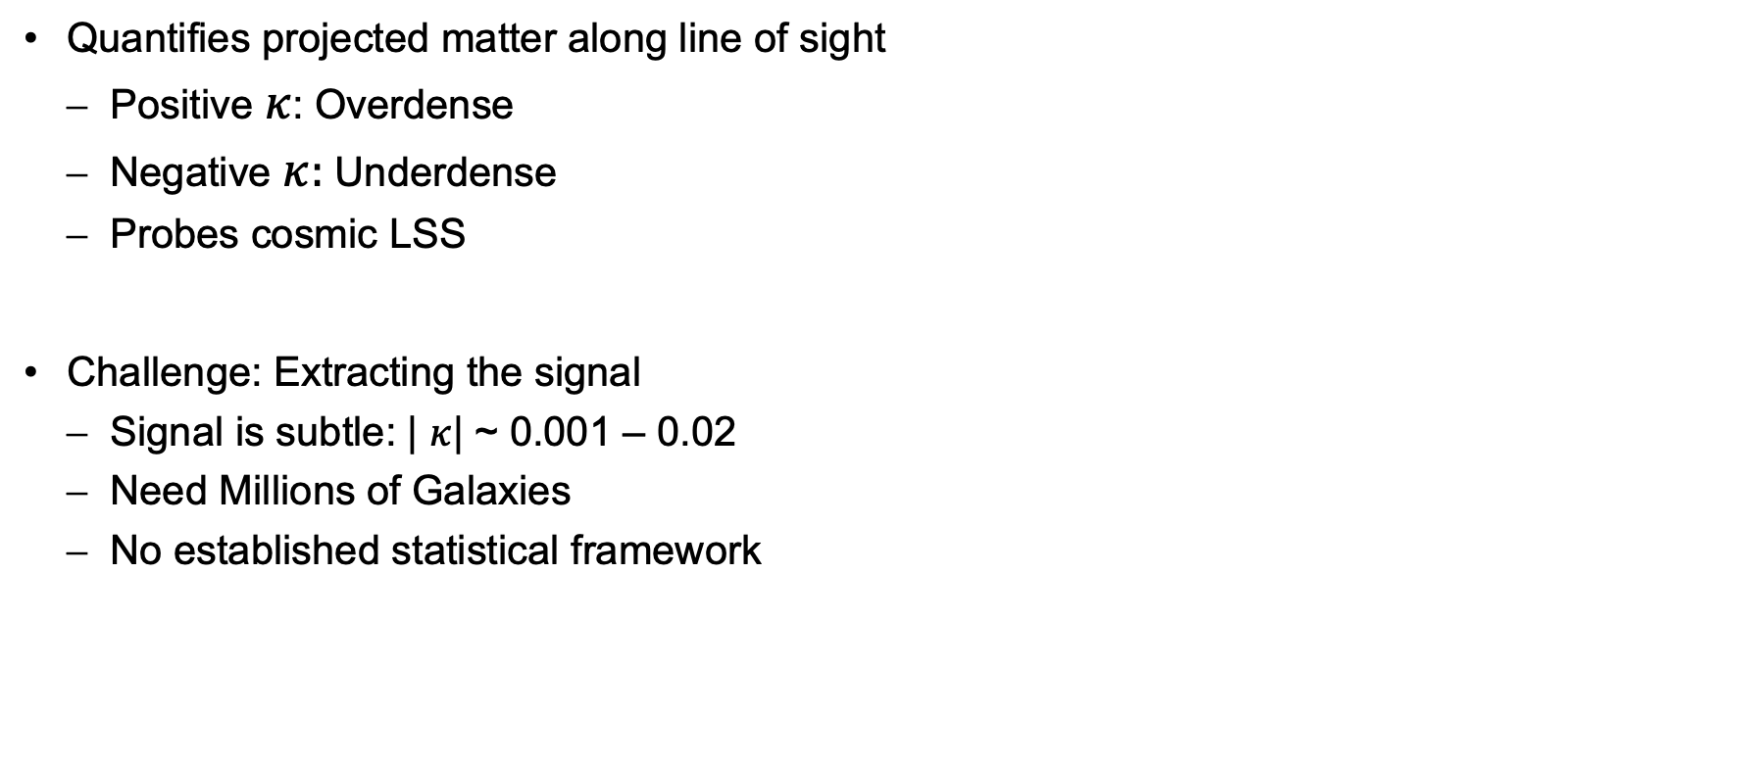
Convergence Maps
Quantifies projected matter along line of sight
Positive $κ$: Overdense
Negative $κ:$ Underdense
Probes cosmic LSS
Challenge: Extracting the signal
Signal is subtle: | $κ$| ~ 0.001 – 0.02
Need Millions of Galaxies
No established statistical framework

Slide 5
Comparing the Size Distributions

Slide 6
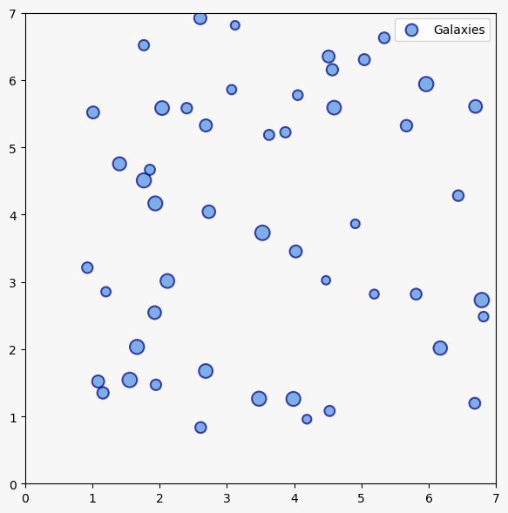
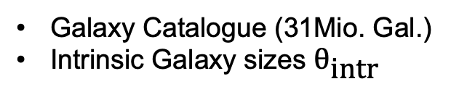
Comparing the Size Distributions
Galaxy Catalogue (31Mio. Gal.)
Intrinsic Galaxy sizes $θ_{\text{intr}}$
Notes:
We use a simulated Galaxy catalogue from Galsbi. 31 million galaxies on a sky patch of 1000deg². Only intrinsic sizes given.

Slide 7
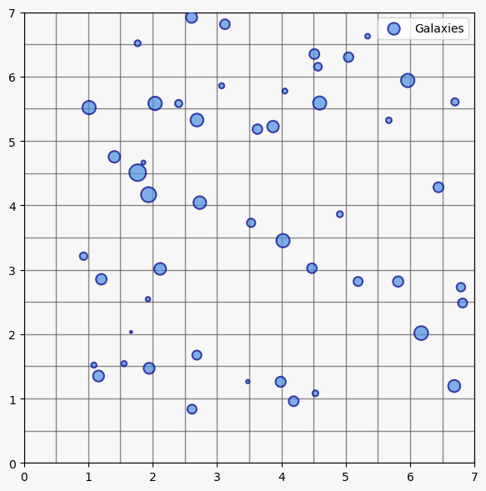
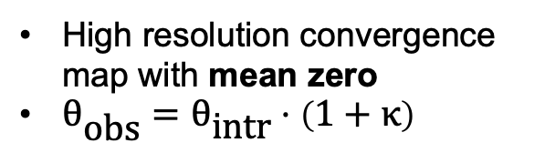
Comparing the Size Distributions
Galaxy Catalogue (31Mio. Gal.)
Intrinsic Galaxy sizes $θ_{\text{intr}}$
High resolution convergence map with mean zero
$θ_{\text{obs}}=θ_{\text{intr}}⋅\left(1+κ\right)$
Notes:
Applying a known pixelized convergence map, we get the observed galaxy sizes with the formula below.
This is the convergence map we want to predict later.
The map has zero mean, such that the size distribution is the same as before lensing.

Slide 8
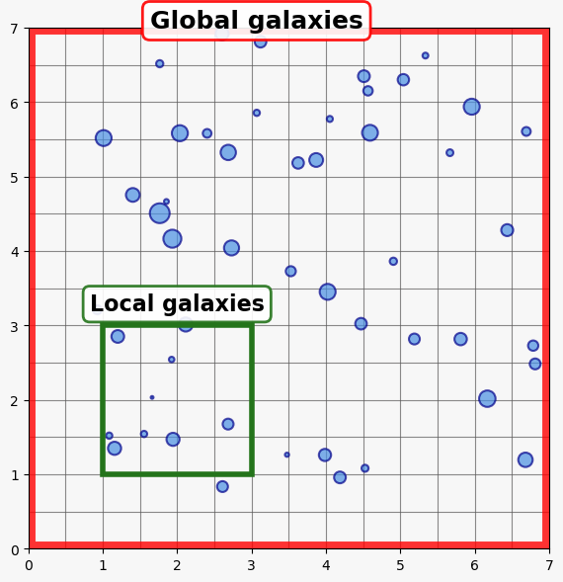
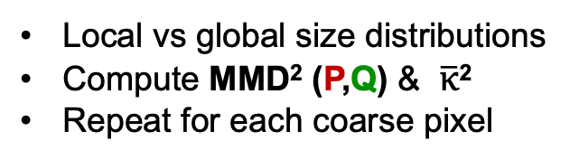
Comparing the Size Distributions
Galaxy Catalogue (31Mio. Gal.)
Intrinsic Galaxy sizes $θ_{\text{intr}}$
High resolution convergence map with mean zero
$θ_{\text{obs}}=θ_{\text{intr}}⋅\left(1+κ\right)$
Local vs global size distributions
Compute MMD² (P,Q) & $\overline{κ}$²
Repeat for each coarse pixel
Notes:
Finally, we compare the size distributions of the local galaxies and the global size distribution given random samples (20‘000).
We do this for each local region. Also compute the mean mean convergence in that region. How do we compare the distributions only from their samples?

Slide 9
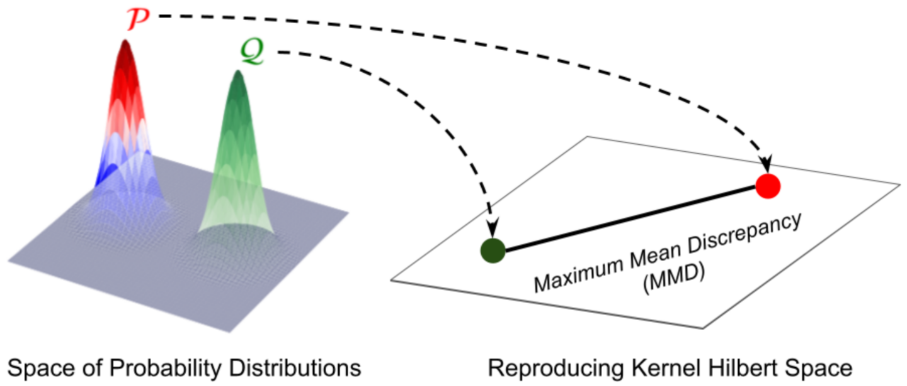
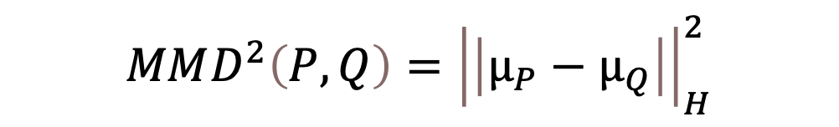
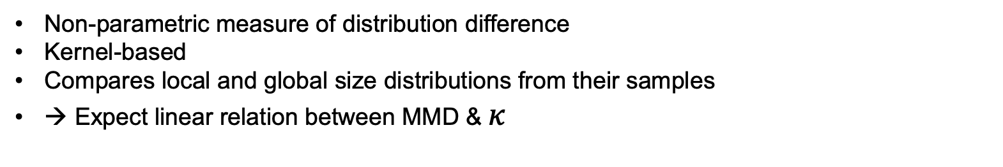
Maximum Mean Discrepancy (MMD)
$$MMD^{2}\left(P,Q\right)={\left|\left|μ_{P}−μ_{Q}\right|\right|}_{H}^{2}$$
Non-parametric measure of distribution difference
Kernel-based
Compares local and global size distributions from their samples
→ Expect linear relation between MMD & $κ$
Notes:
We use a statistical tool called MMD.
This is a kernel-based method. Given their samples, the two distributions are embedded in a Reproducing Kernel Hilbert Space.
The MMD is then just the distance in that Space.
Different kernels give different RKHS, that can not be compared.

Slide 10
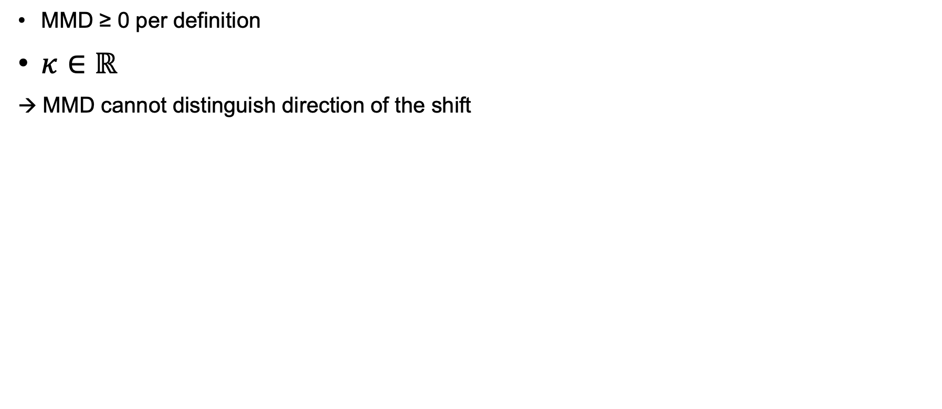
The Sign Problem
MMD ≥ 0 per definition
$κ∈ℝ$
→ MMD cannot distinguish direction of the shift
Notes:
As you may have noticed there is a problem with this tool.
It is always non-negative and can therefore not distinguish the direction of the shift.
Without direction, we cannot distinguish positive from negative convergence values.

Slide 11
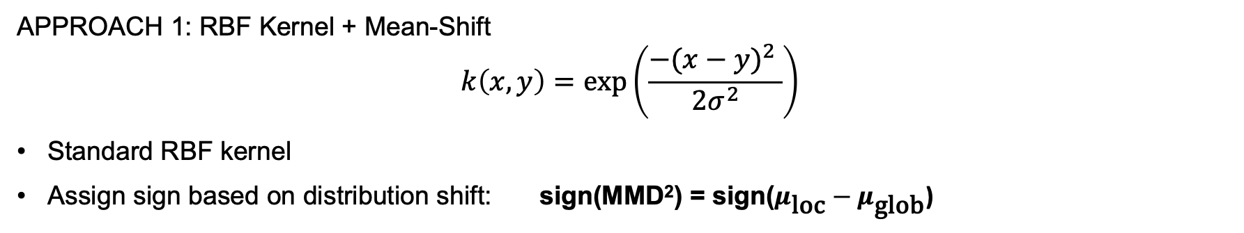
Two Solutions to the Sign Problem
APPROACH 1: RBF Kernel + Mean-Shift
$$k\left(x,y\right)=\text{exp}\left(\frac{{−(x−y)}^{2} }{2σ^{2}}\right)$$
Standard RBF kernel
Assign sign based on distribution shift: sign(MMD²) = sign($μ_{\text{loc}}−μ_{\text{glob}}$)
Notes:
To resolve this problem, we have two solutions.
Standard RBF kernel: gives only positive MMD
We assign the sign by the direction of the mean-shift.

Slide 12
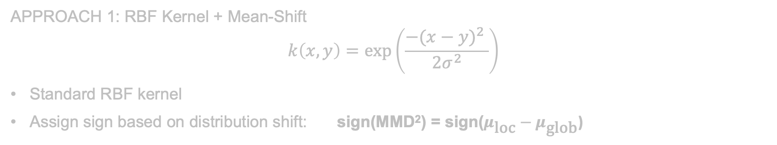
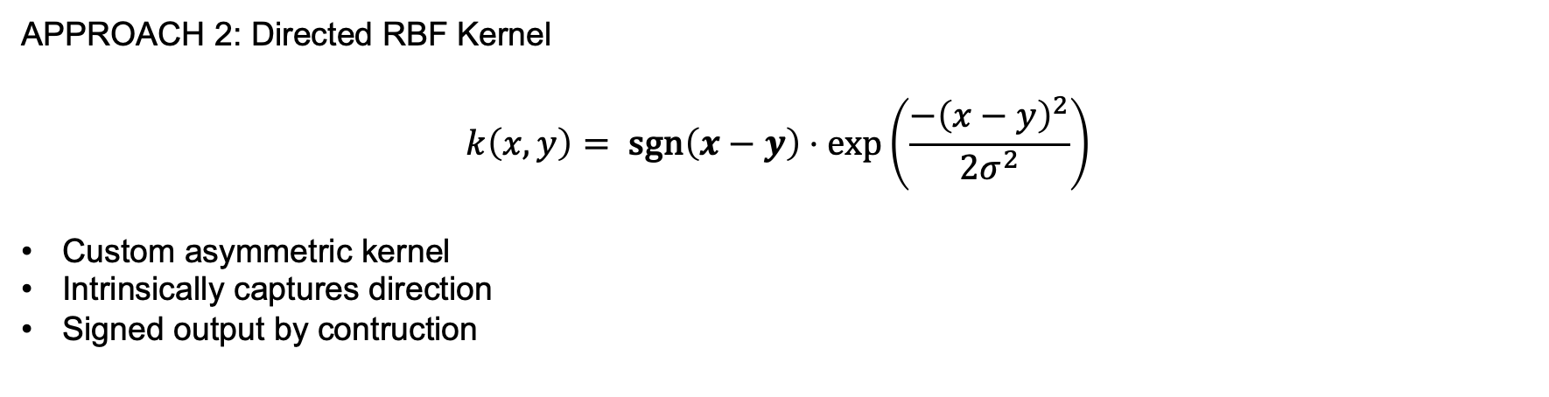
Two Solutions to the Sign Problem
APPROACH 1: RBF Kernel + Mean-Shift
$$k\left(x,y\right)=\text{exp}\left(\frac{{−(x−y)}^{2} }{2σ^{2}}\right)$$
Standard RBF kernel
Assign sign based on distribution shift: sign(MMD²) = sign($μ_{\text{loc}}−μ_{\text{glob}}$)
APPROACH 2: Directed RBF Kernel
$$k\left(x,y\right)= \text{sgn}\left(x−y\right)⋅\text{exp}\left(\frac{−{\left(x−y\right)}^{2}}{2σ^{2}}\right)$$
Custom asymmetric kernel
Intrinsically captures direction
Signed output by contruction
Notes:
Our 2nd Approach is totally different. We try to capture the sign intrinsically with a customized kernel. The sgn(x-y) term, gives an asymmetry, that helps capturing the direction.
We get a signed MMD by construction.

Slide 13
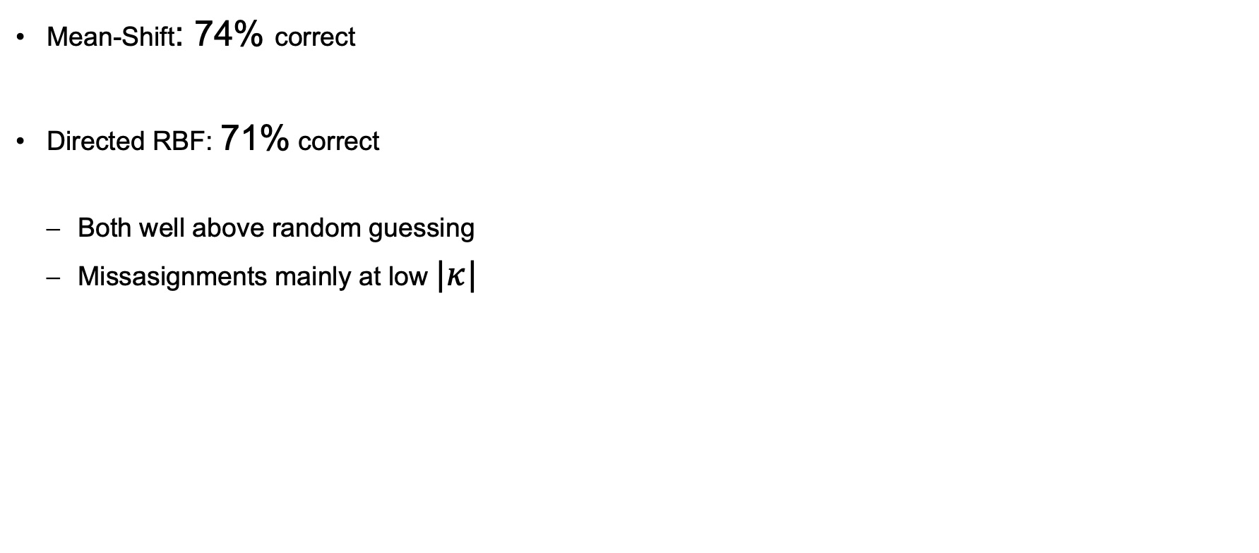
Sign Assignment: Validation
Mean-Shift: 74% correct
Directed RBF: 71% correct
Both well above random guessing
Missasignments mainly at low $|κ|$

Slide 14
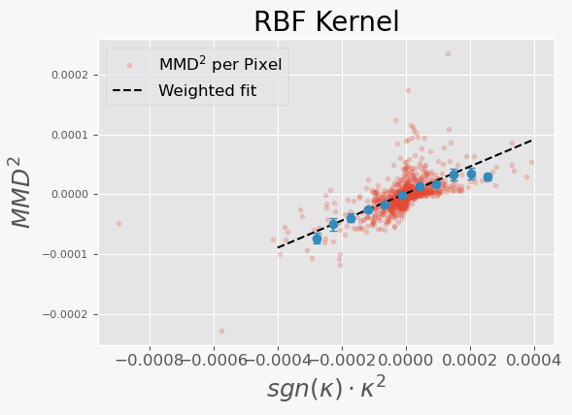
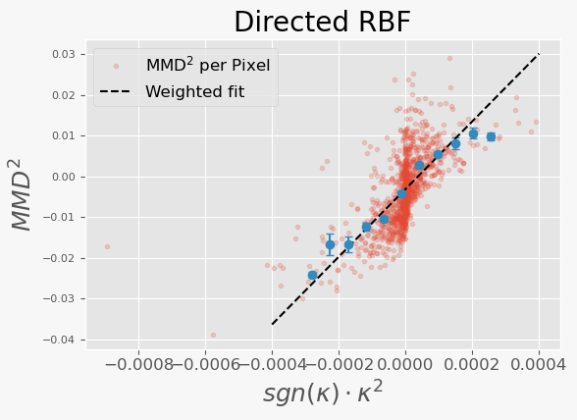
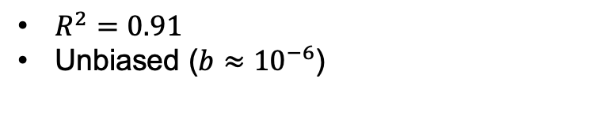
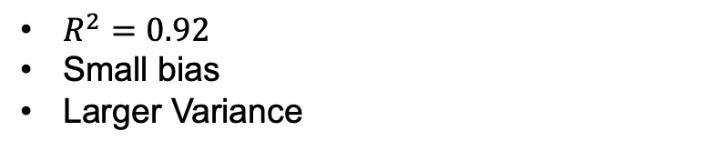
Linear Estimators
$R^{2}=0.91$
Unbiased ($b≈{10}^{−6}$)
$R^{2}=0.92$
Small bias
Larger Variance
→ Focus on RBF estimator for remaining results
Notes:
Here we see the computed MMD2 for each local region as the red dots. Because of the large variance, we took averages over kappa-bins.
The Fit is a simple weighted linear fit assuming gaussian noise. So just a weighted least squares.
Both fits have a good R2-score. But notice that the fit for the Dir. RBF has a small non-negligable bias term.
It is not an issue if that estimator can still reconstruct the convergence map.
Due to time constraints, and because the results are similar, I will only focus on the RBF kernel from now on.

Slide 15
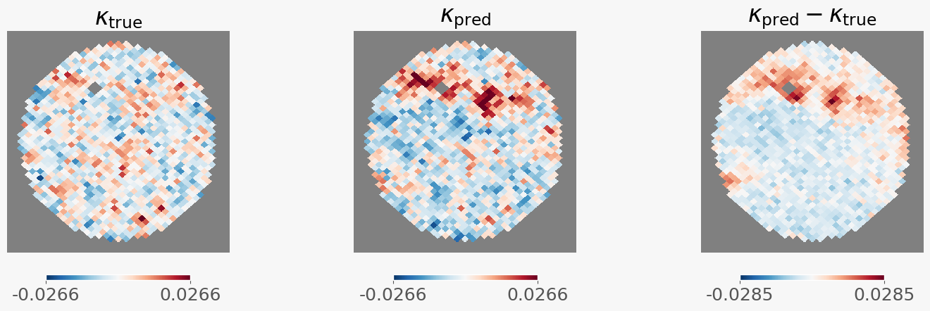
Pixel-level Recovery of Convergence Map
Residuals mostly small and random
Overprediction in upper region
Notes:
Left: True convergence map that we want to reconstruct this with our estimator
Center: Our prediction from the linear estimator.
Right: Residuals
Notice: Overprediction in the upper region, few white pixels(→ cannot predict values close to zero)

Slide 16
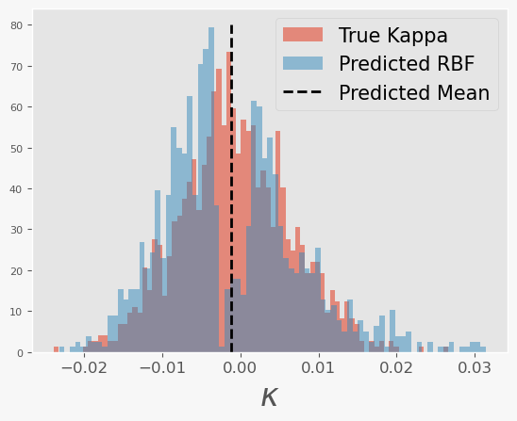
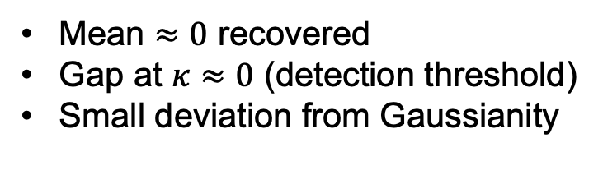
Statistical Recovery
Mean $≈0$ recovered
Gap at $κ≈0$ (detection threshold)
Small deviation from Gaussianity
Notes:
As I said, the convergence map is modelled as a Gaussian Random field. Can we recover this gaussianity?
Mean is close to zero.
Limitation: We cannot obtain convergences close to zero. Those values get actually pushed away from zero towards more negative or positive values. → Bimodal distribution
This also leads to a small deviation from Gaussianity.

Slide 17
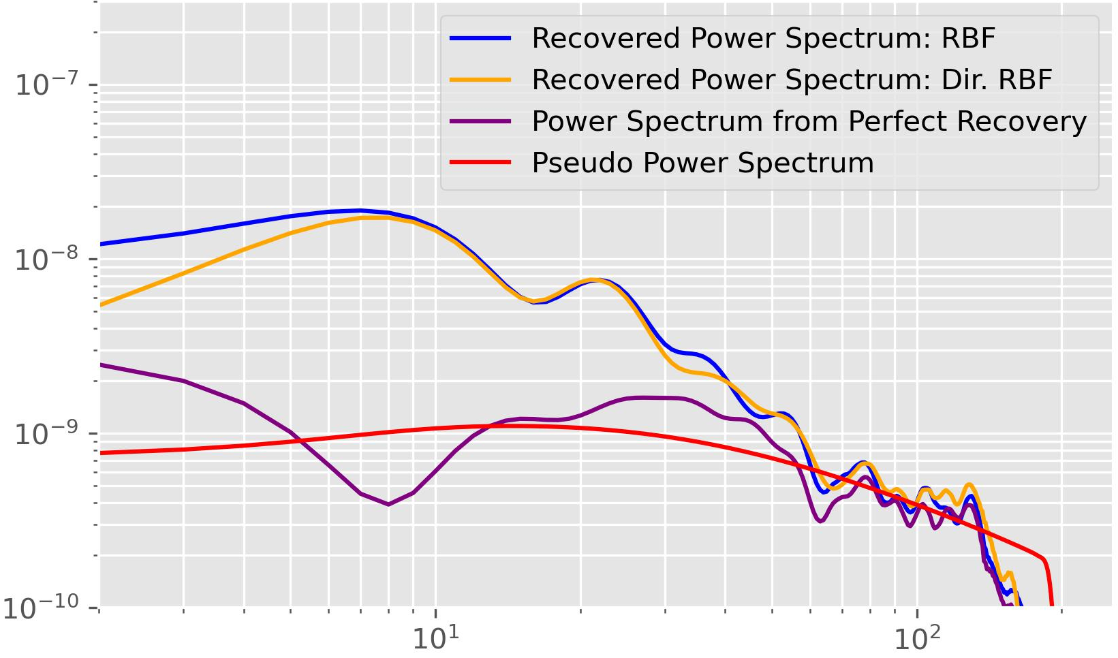
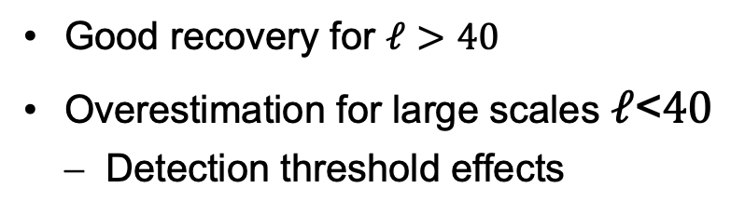
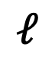

Statistical Recovery
$$∁_{ℓ}$$
$$ℓ$$
Mean $≈0$ recovered
Gap at $κ≈0$ (detection threshold)
Small deviation from Gaussianity
Good recovery for $ℓ>40$
Overestimation for large scales $ℓ$<$40$
Detection threshold effects
Notes:
Finally, the most important statistic. Can we actually recover the power spectrum? Only partially.
For small scales, starting from around ell=40, we have a good recovery.
While on large scales, we very much overpredict the power.
For the smallest scales, it is expeccted to have a large uncertainty. Unfortunately we couldn‘t recover multiple convergence maps to quantify this uncertainty.
Other reasons for the excess power are the overpredicted regions introduce structures that are not present in the true field.
Also, by pushing convergence values away from zero, we get many more pixels with similar values. Appearing as if there was lots of correlation between them.

Slide 18
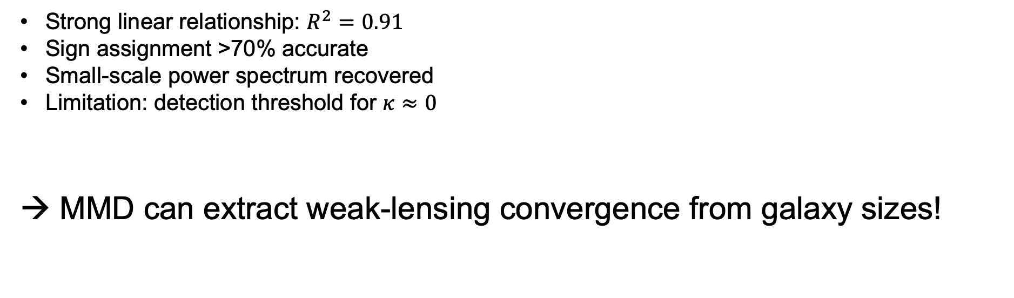
Key Findings
Strong linear relationship: $R^{2}=0.91$
Sign assignment >70% accurate
Small-scale power spectrum recovered
Limitation: detection threshold for $κ≈0$
→ MMD can extract weak-lensing convergence from galaxy sizes!

Slide 19
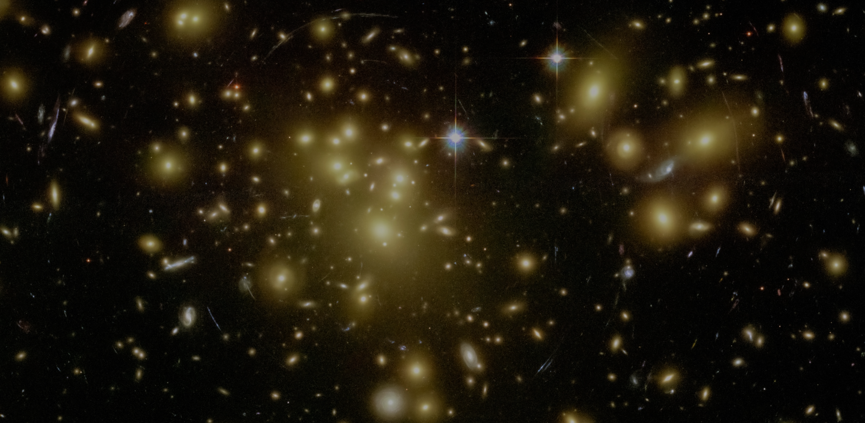
Thank you!
QUESTIONS?
NASA Hubble Space Telescope

Slide 20
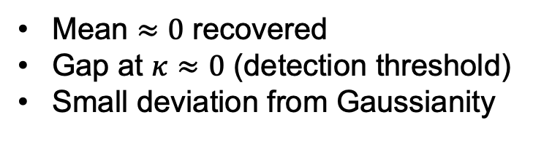
Statistical Recovery
Mean $≈0$ recovered
Gap at $κ≈0$ (detection threshold)
Small deviation from Gaussianity
Notes:
As I said, the convergence map is modelled as a Gaussian Random field. Can we recover this gaussianity?
Mean is close to zero.
Limitation: We cannot obtain convergences close to zero. Those values get actually pushed away from zero towards more negative or positive values. → Bimodal distribution
This also leads to a small deviation from Gaussianity.

Slide 21
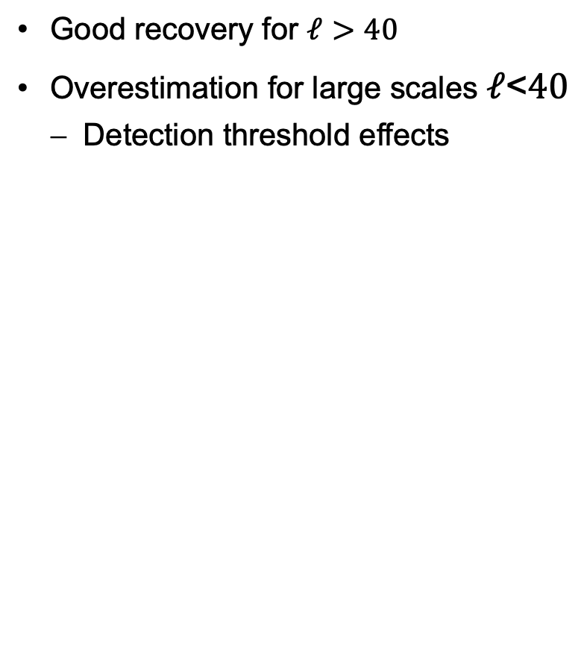
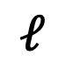

Power Spectrum Recovery
Good recovery for $ℓ>40$
Overestimation for large scales $ℓ$<$40$
Detection threshold effects
$$∁_{ℓ}$$
$$ℓ$$
Notes:
Finally, the most important statistic. Can we actually recover the power spectrum? Only partially.
For small scales, starting from around ell=40, we have a good recovery.
While on large scales, we very much overpredict the power.
For the smallest scales, it is expeccted to have a large uncertainty. Unfortunately we couldn‘t recover multiple convergence maps to quantify this uncertainty.
Other reasons for the excess power are the overpredicted regions introduce structures that are not present in the true field.
Also, by pushing convergence values away from zero, we get many more pixels with similar values. Appearing as if there was lots of correlation between them.

Slide 22
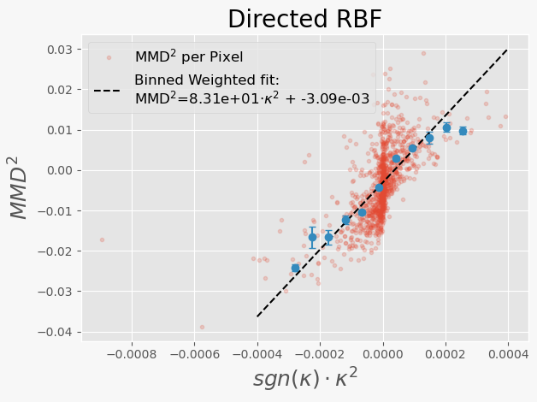
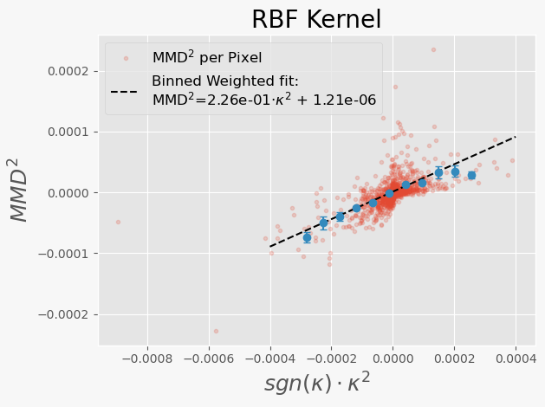
Linear Estimators
$R^{2}=0.91$
Unbiased ($b≈{10}^{−6}$)
$R^{2}=0.92$
Small bias
Larger Variance
→ Focus on RBF estimator for remaining results

Slide 23
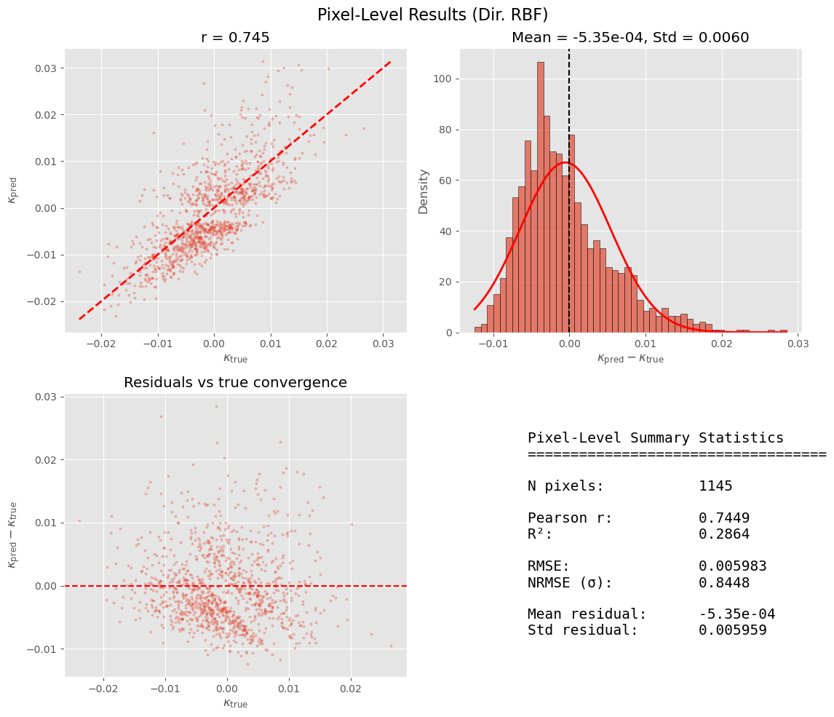
PIXEL LEVEL RESULTS (RBF)

Slide 24
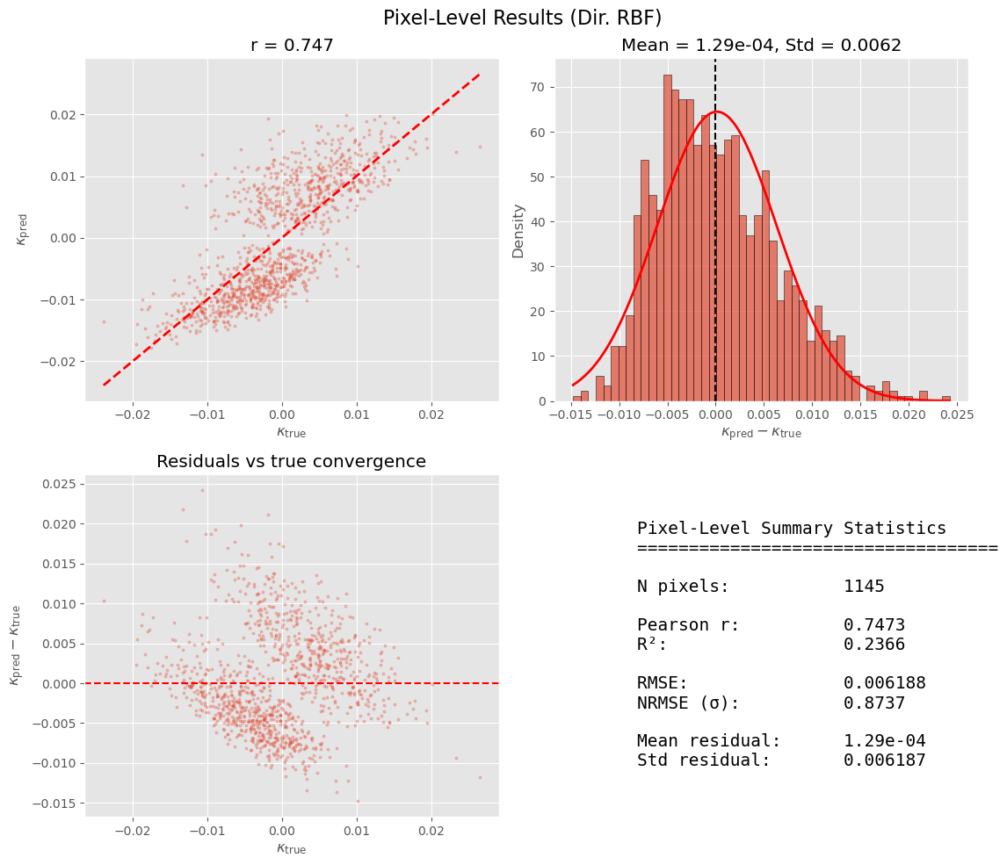
PIXEL LEVEL RESULTS (DIR. RBF)

Slide 25
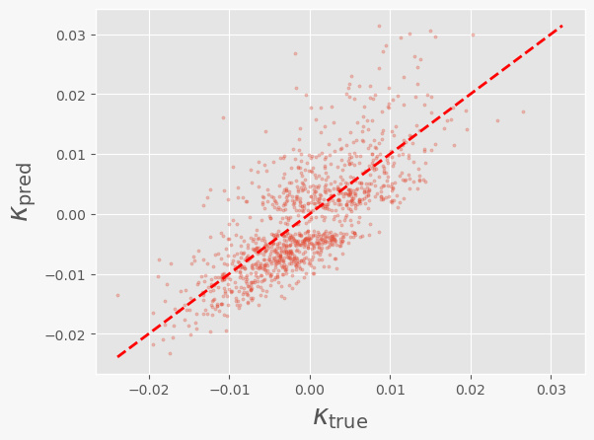
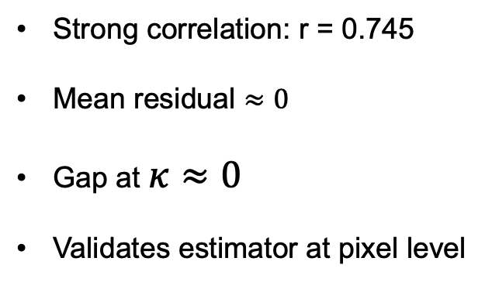
Pixel-level Recovery of the Convergence Map
Strong correlation: r = 0.745
Mean residual $≈0$
Gap at $κ≈0$
Validates estimator at pixel level

Slide 26
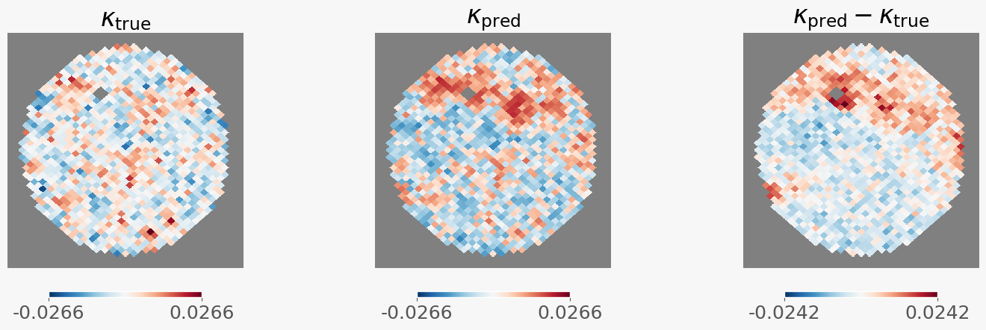
Spatial Convergence Map (Directed RBF)

Slide 27
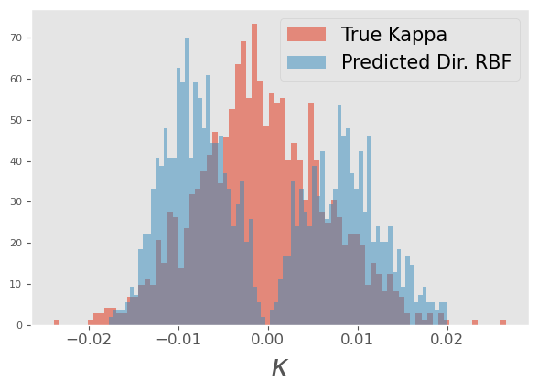
Convergence Histogram (Directed RBF)

